Slide 1

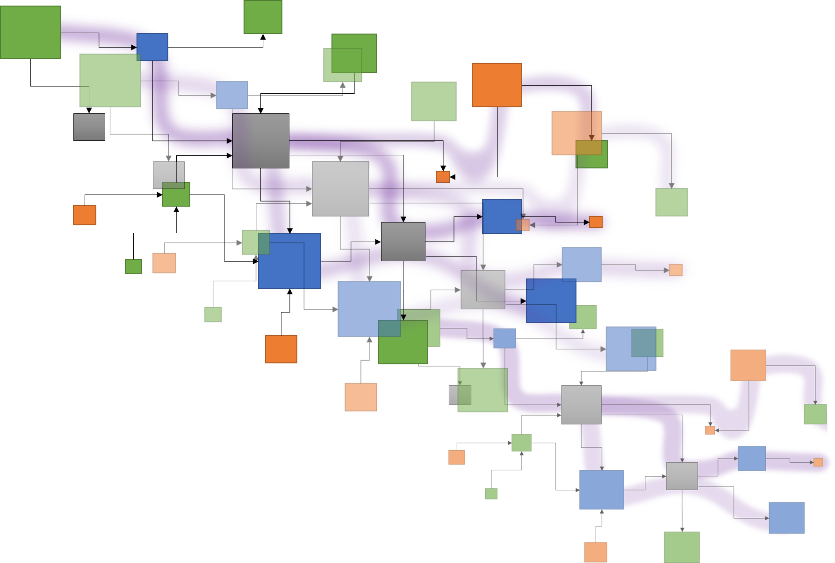
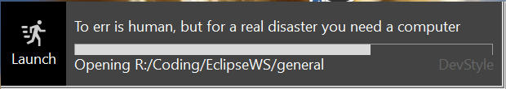





Tracea – 6th deliverable
Reference forensic
Deliverable 6
Exploring Papyrus typology
Traceα
Topology and complexity of
Papyrus DSL creation
Edouard R. Batot
Mai 2022

Slide 2
Tracea – 6th deliverable
A study of Papyrus –
Topology and complexity of DSL orchestration..
Reference forensic
.. a semi-automated analysis
Task 6:
Evaluation of the potential advantages of using the distance valuation for dealing with the complexity of traceability. Potential study case: establish a heat chart for the change impact analysis.
Exploring Papyrus DSL orchestration
Deliverable 6:
Case study. Exploration of different scenarios that would benefit from a socio-technical traceability language or distance functions to reduce accidental complexity thanks to tracing. (For example: customization of views according to the "distance" between the artefacts on a matrix heat chart).
Edouard R. Batot
Mai 2022

Slide 3
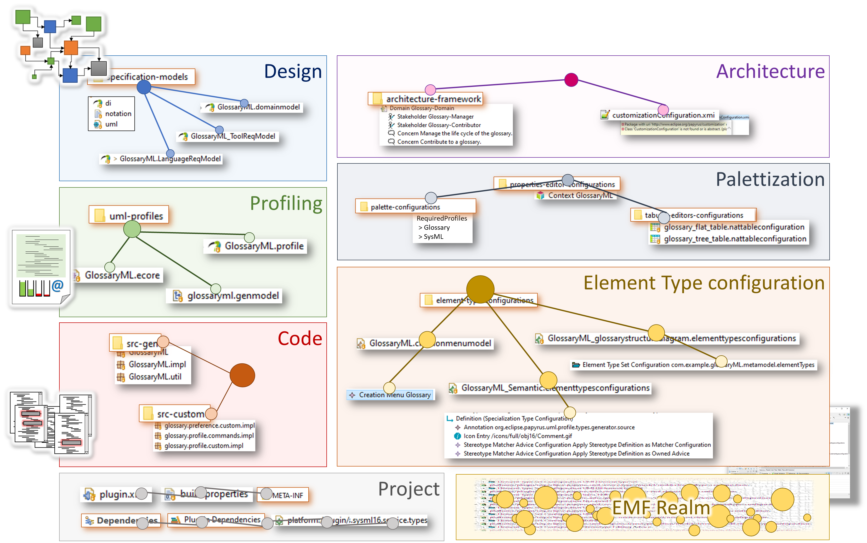
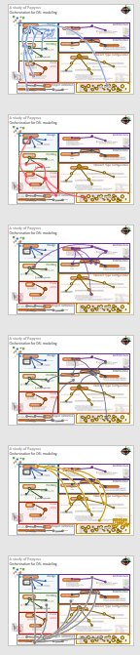
Orchestration for DSL modeling: A study of Papyrus
Papyrus modules & dependencies
Exploring Papyrus DSL orchestration

Slide 4
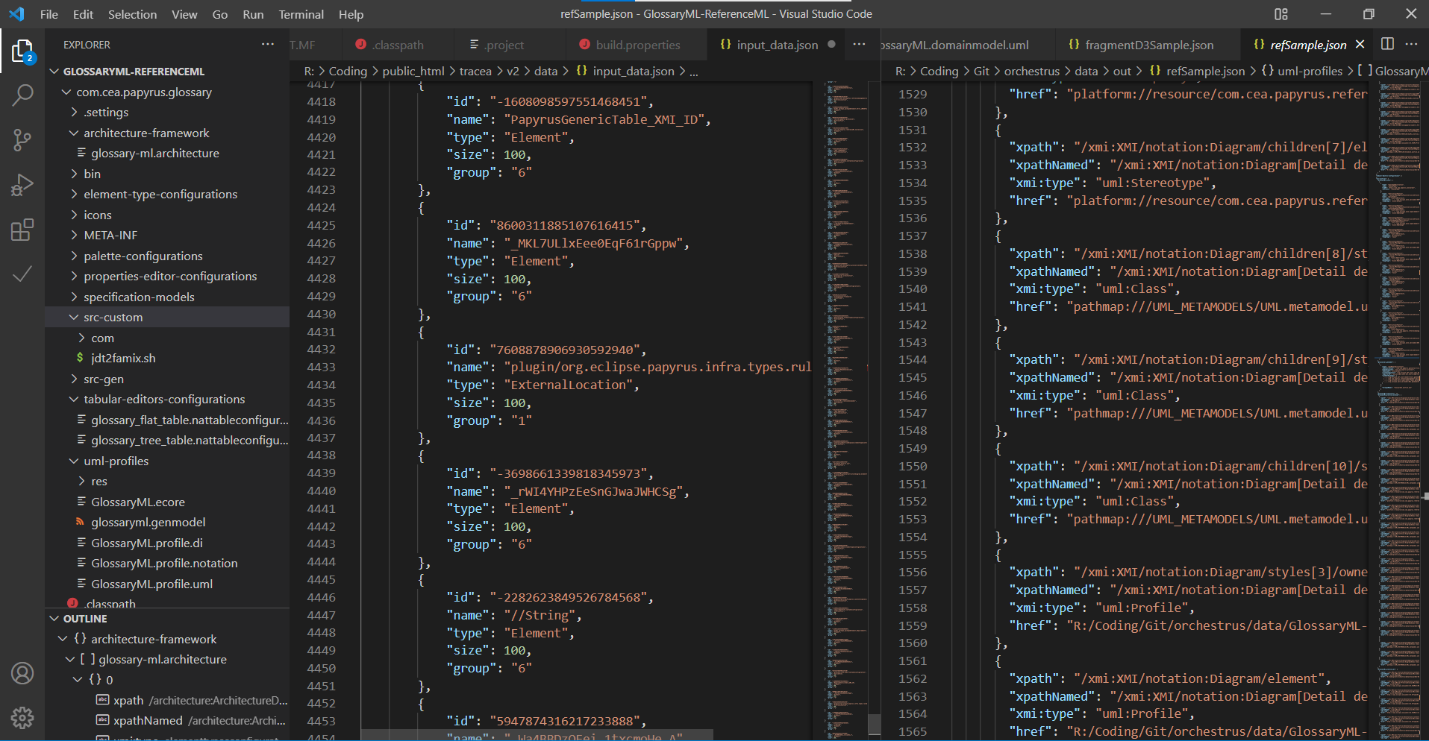
Persistence break.
Reference forensic
XMI
Artefacts
Configuration
Exploring Papyrus DSL orchestration
Custom
Java
Modeling
persistence

Slide 5
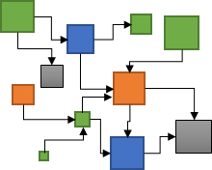
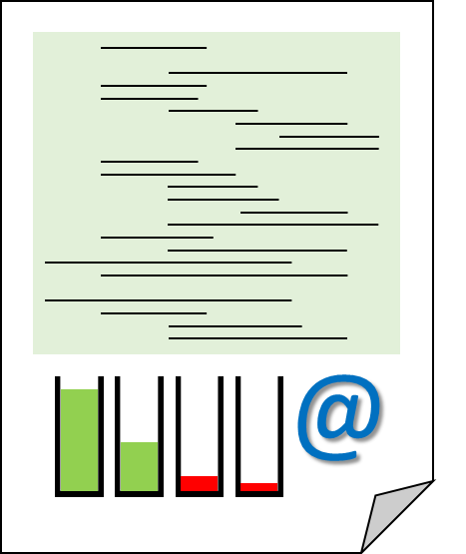
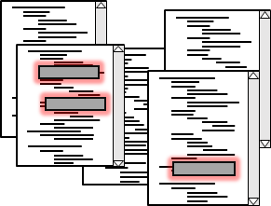
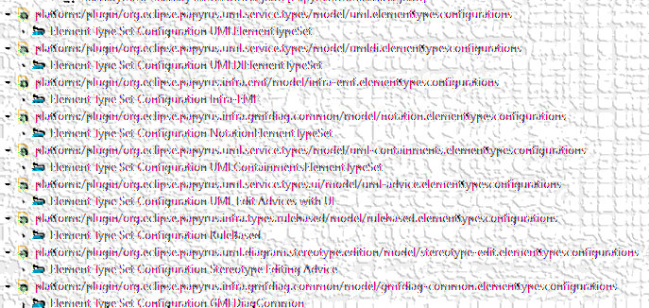
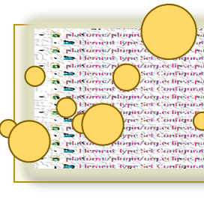
Reference forensic.
What is a reference
Nature, source
Solvability
What matters in a reference
Source file, target,
Frequency?
Reference forensic
XMI
XML et al.
Exploring Papyrus DSL orchestration
"href": "platform://plugin/org.eclipse.papyrus.uml.service.types/model/
uml.elementtypesconfigurations
#_ScP1oFYCEeS0WsAAtVmToA"
Java files
HREF
Protocol
://
location
Context
name
#
File artefacts
innerlocation
URI
Precise target element
SysML
Ecore
EMF Realm

Slide 6
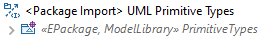

Reference forensic.
Root folder
Reference forensic
Root
Path to element
Path to element
External Element
Path to element
UML primitive
Exploring Papyrus DSL orchestration
Related
libraries
External Element
View
Context
SysML/Req
Local Element
Design
Architecture
Palettization
External location
Local file
Profiling
Element Type configuration
Code
Related project
Project
EMF Realm
Local root

Slide 7
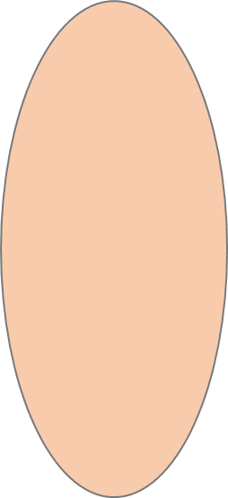
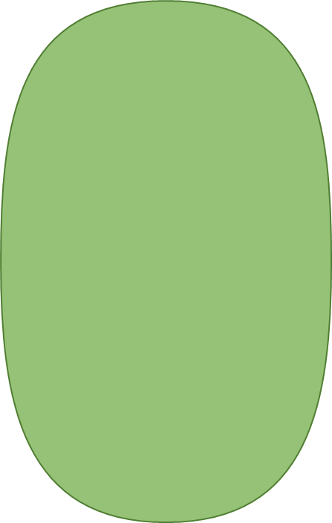
Reference forensic.
Reference forensic
Exploring Papyrus DSL orchestration
Dependences
Related
Projects
External locations
Unresolved locations

Slide 8
Reference forensic.
Impacted elements
Reference forensic
Design
Inter-module connections map
Code
Profiling
Maps modules external dependencies
Eases exploration of dependencies
Guides connections typing
Exploring Papyrus DSL orchestration
Architecture
Element Type configuration
Palettization

Slide 9

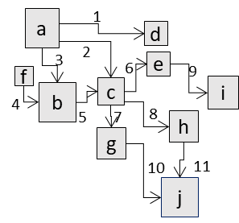
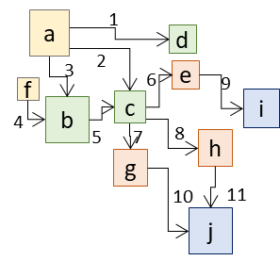
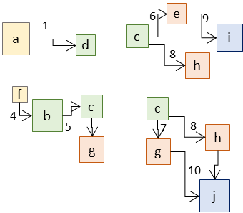


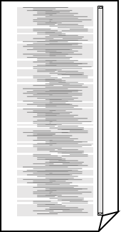
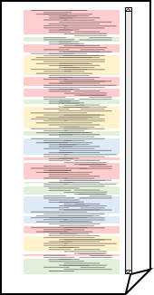
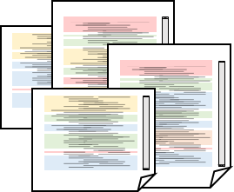
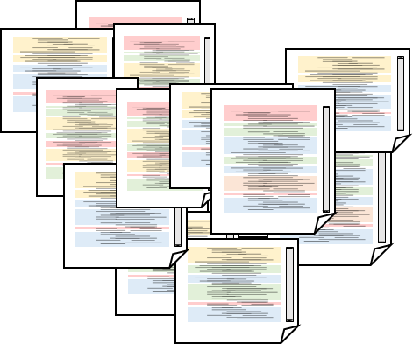

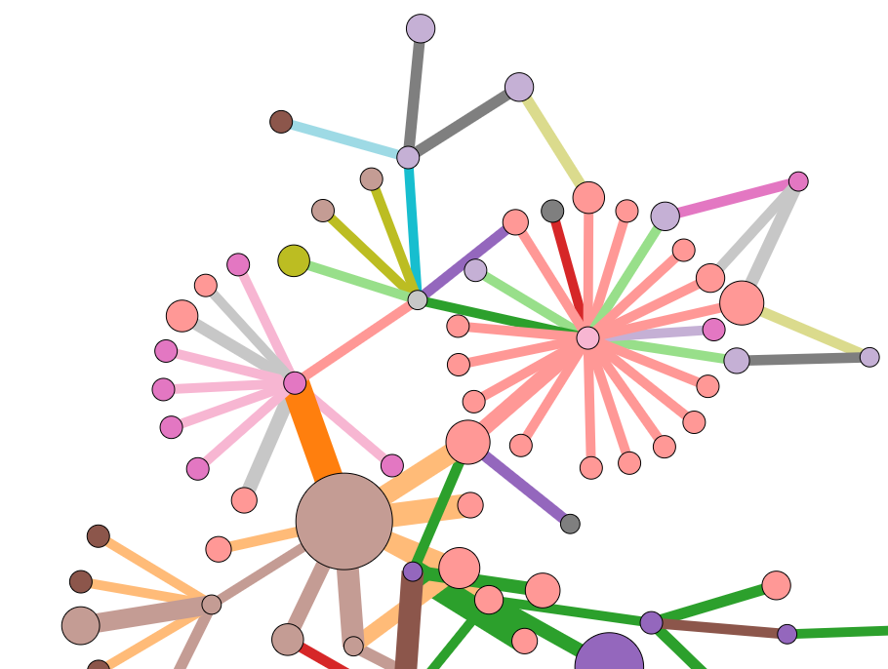
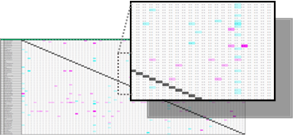
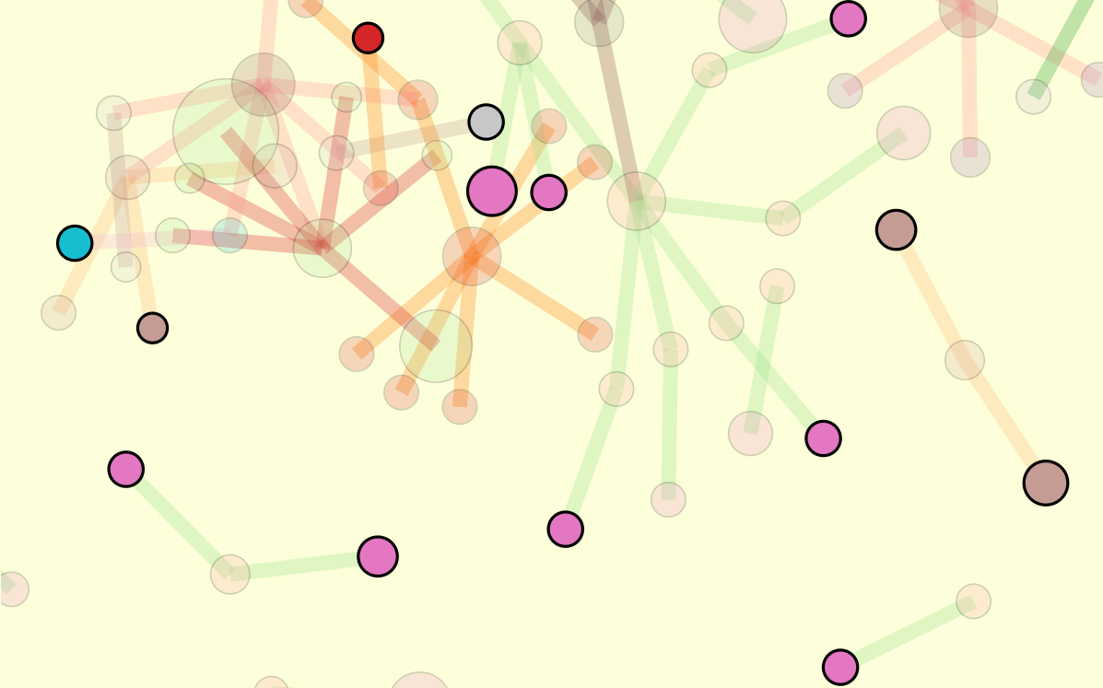
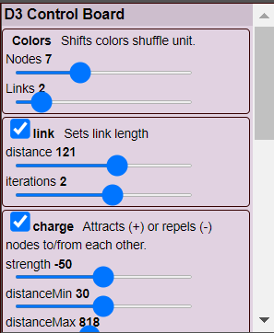
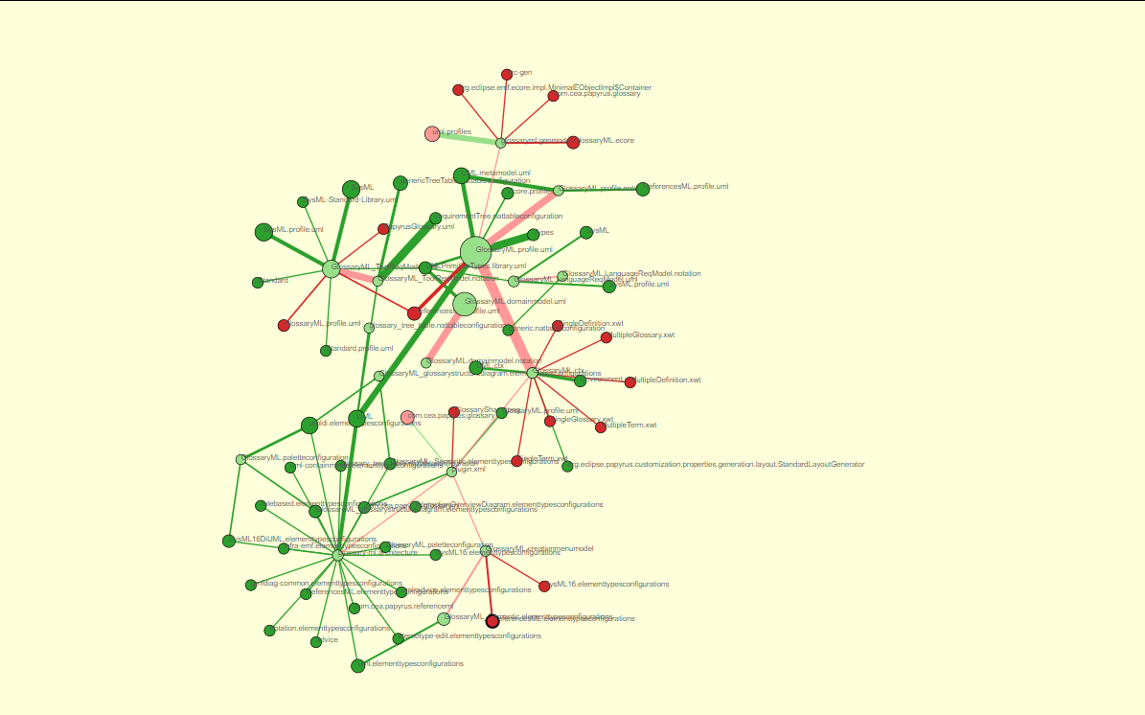
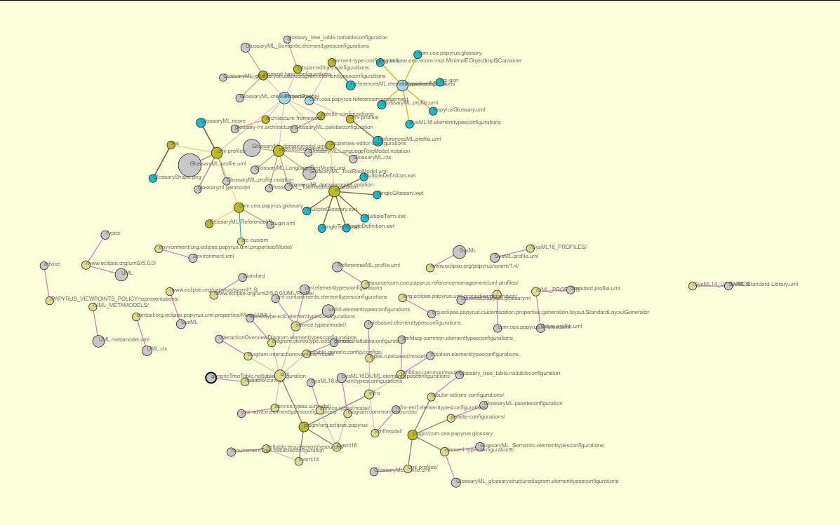
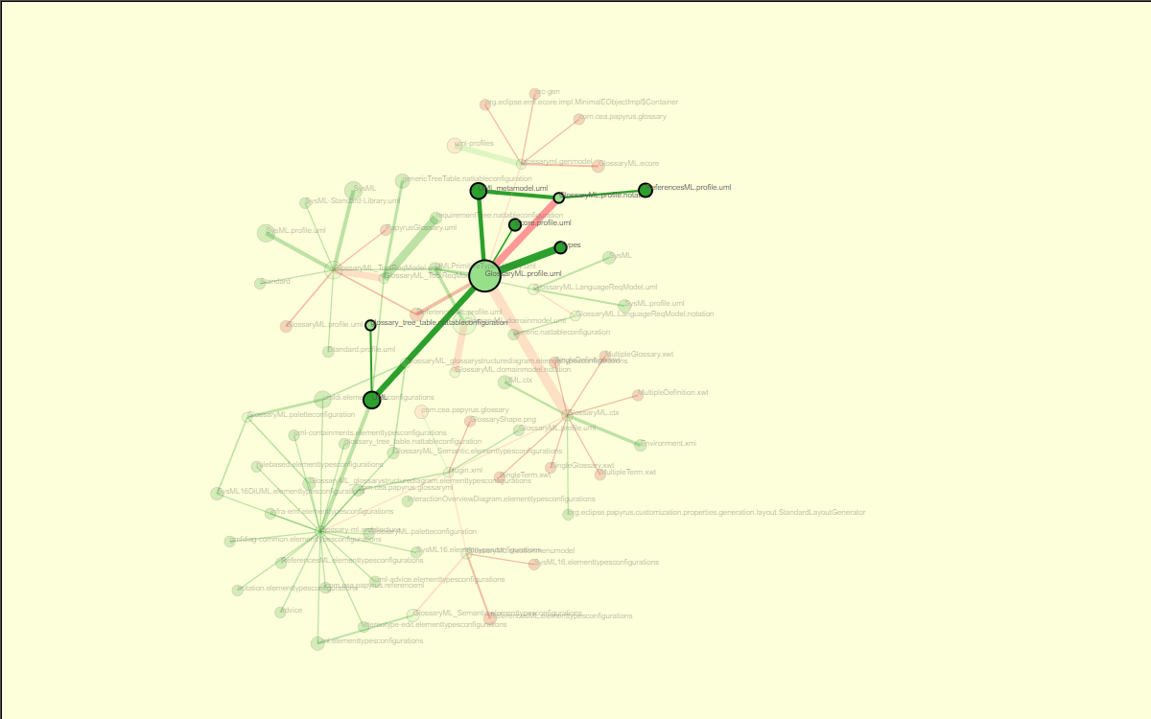

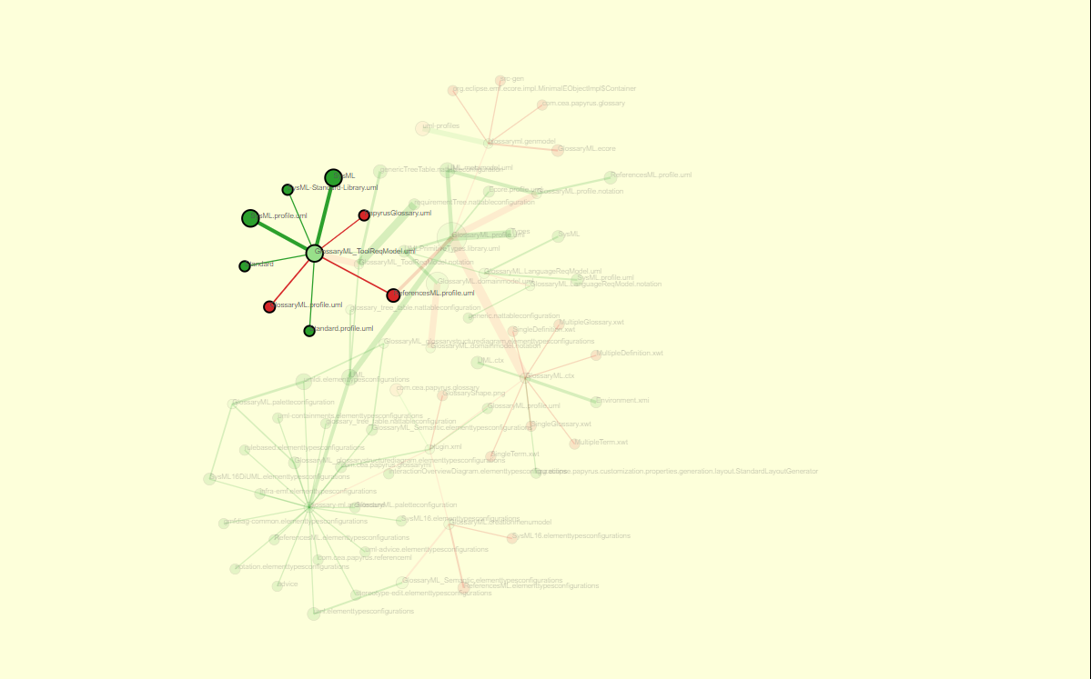
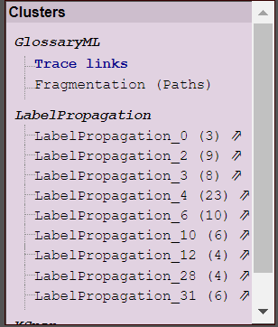
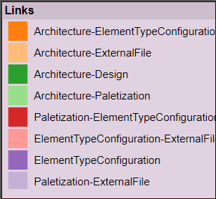
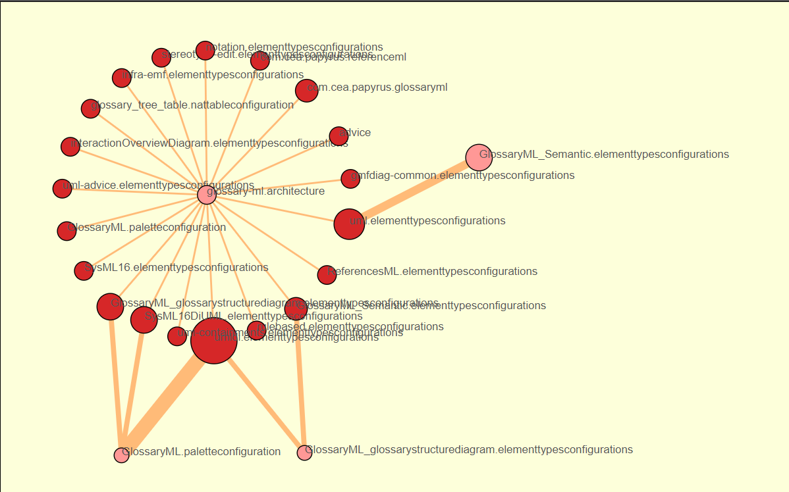
Topology and complexity of Papyrus-based DSL creation: A semi-automated analysis
1
2
3
4
·
Orchestrus: Analyzing Papyrus DSL artefacts relationship
Tracea
Papyrus DSL project
Relationship identification
TraceaML instantiation
Artefacts and links valuation
Semi-automated
analysis
a
d
Typed trace
Typed clusters
c
e
DSL persistence
References
Trace
f
h
b
g
Parsing
j
i
Modeling
Typing
Desiccation
Configuration
- Folders
- Dependencies
- Src-custom
- Specific formats
{Json}
{Json}
{Json}
{Json}
Configuration
- Clustering algos
- Algos parameters
- Clusters min size
Artefacts
Fragmentation and Relationships
Artefacts
Fragmentation and Relationships
List of references
Clusters
(+ Heatmap)
Papyrus persistence
Visualization with TraceaD3
JSon
Relationships
Fragmentation
Java
Tracea
TraceaD3
D3
Orchestrus
Sensitive areas
Interaction
- Browse & search
- Emphasize clusters
- Show paths
TraceaML
Notes:
9

Slide 10
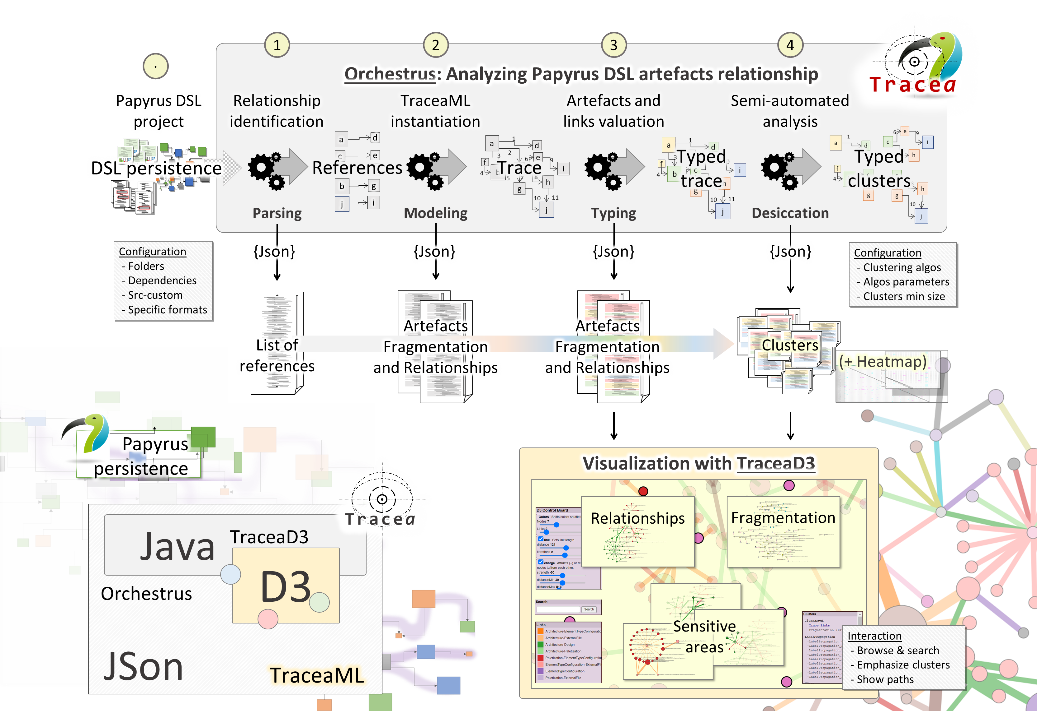

Topology and complexity of Papyrus-based DSL creation: A semi-automated analysis
Papyrus persistence
JSon
Java
Tracea
Orchestrus
Notes:
10

Slide 11

Topology and complexity of Papyrus-based DSL creation: A semi-automated analysis
Papyrus persistence
JSon
Java
Tracea
Orchestrus
TraceaML
Notes:
11

Slide 12
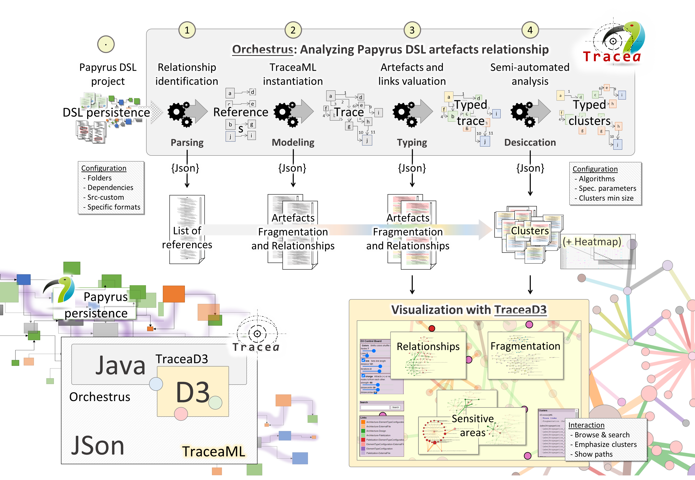

Topology and complexity of Papyrus-based DSL creation: A semi-automated analysis
Papyrus persistence
JSon
Java
Tracea
Orchestrus
TraceaML
Notes:
12

Slide 13
Topology and complexity of Papyrus-based DSL creation: A semi-automated analysis
Papyrus persistence
JSon
Tracea
D3
TraceaML
Notes:
13

Slide 14

Topology and complexity of Papyrus-based DSL creation: A semi-automated analysis
Notes:
14

Slide 15
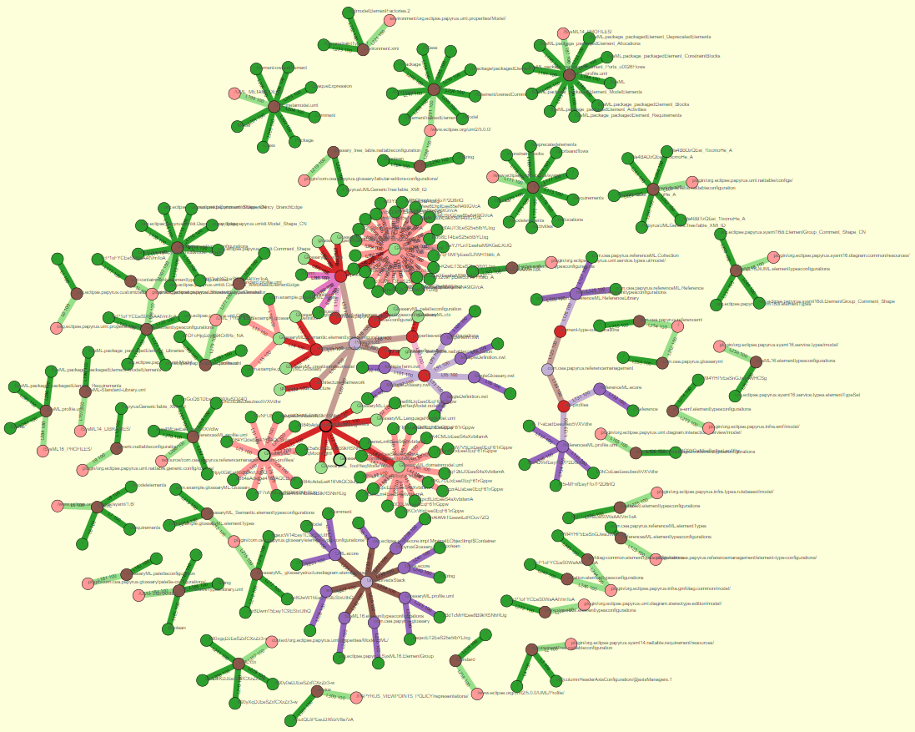
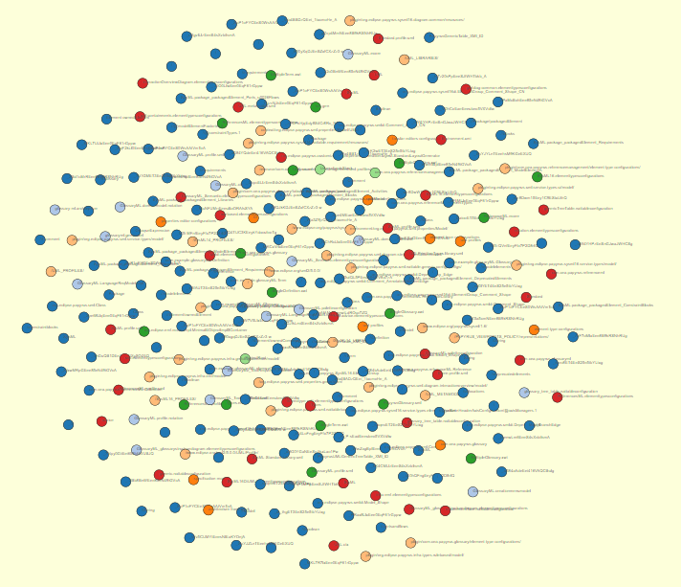
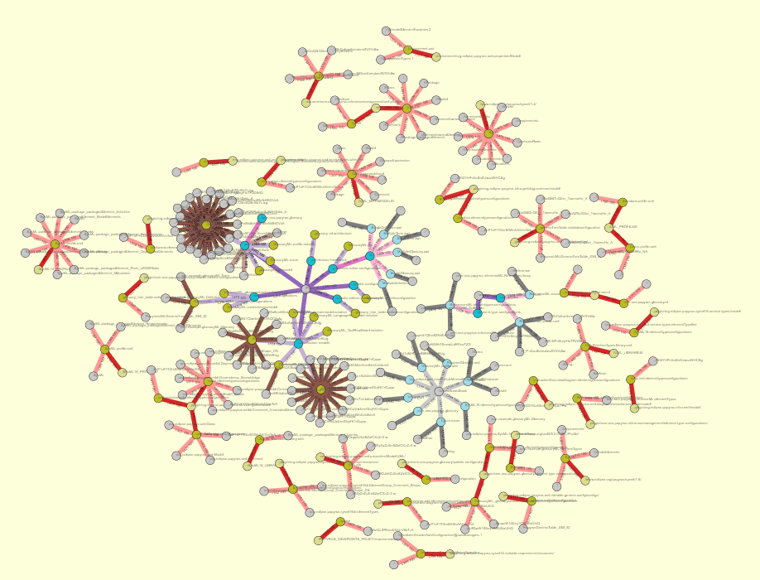
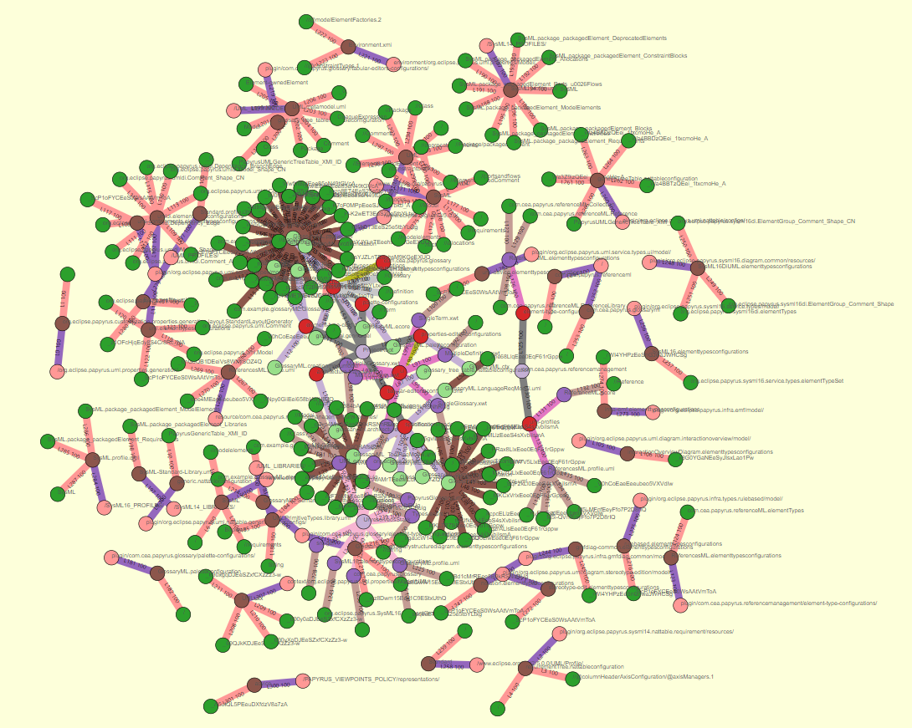
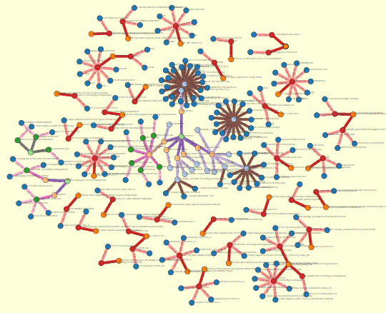
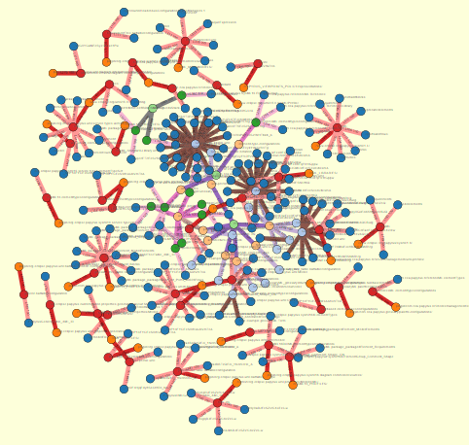
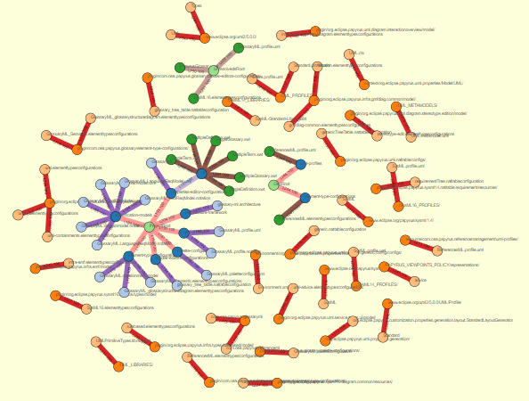
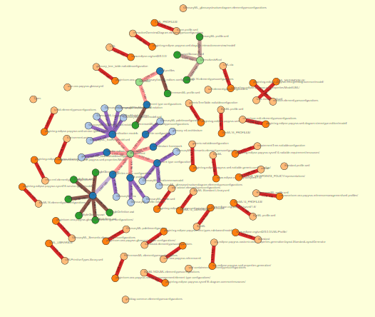
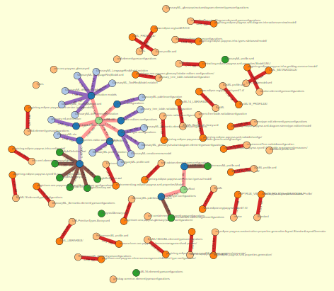
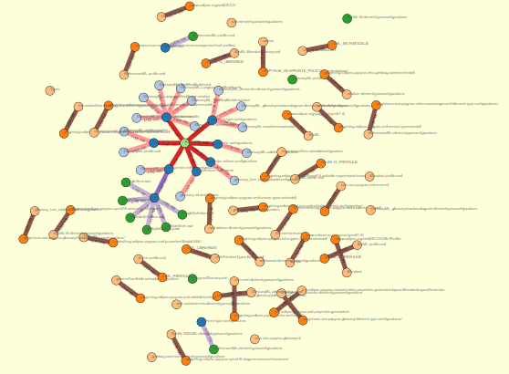
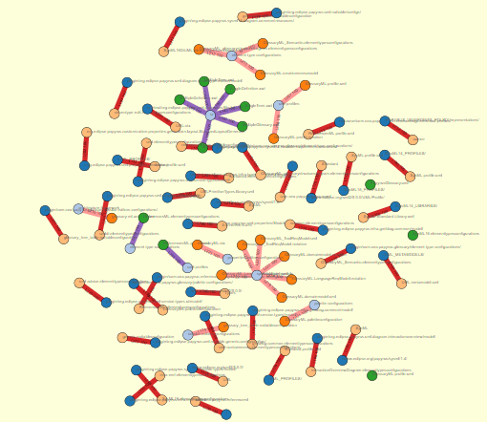
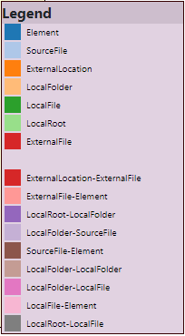
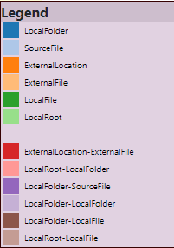
Topology of
a Papyrus project
Topology
Exploring Papyrus DSL orchestration
data/input_trace_data.json&nc=4&lc=4

Slide 16
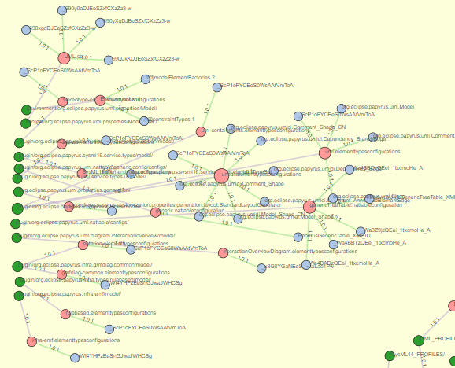
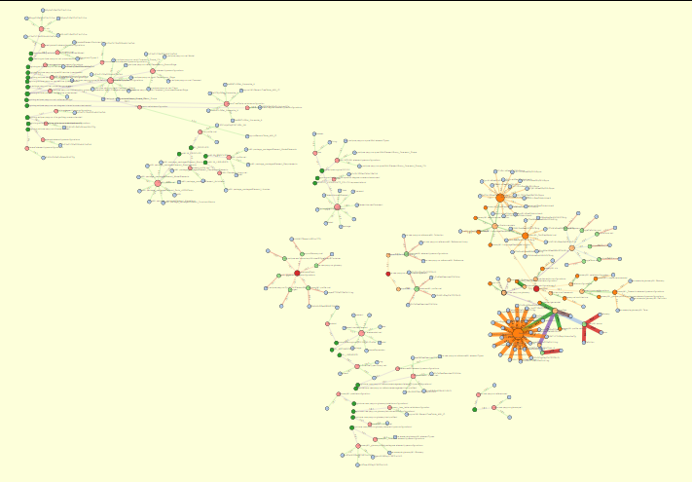
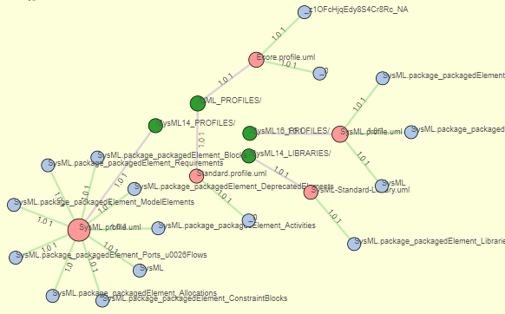
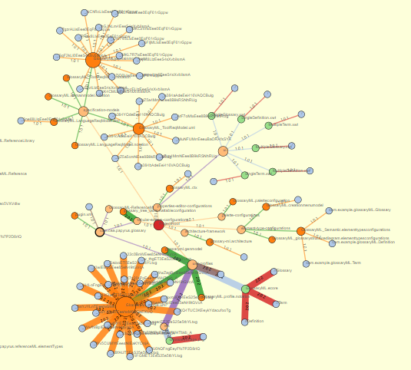



Topology of
a Papyrus project
Reference forensic
Papyrus
“Phases”
Exploring Papyrus DSL orchestration
UML
GlossaryML
SysML
Unresolved
ReferenceML

Slide 17
Topology of
a Papyrus project
Topology
Exploring Papyrus DSL orchestration

Slide 18



















Topology of
a Papyrus project
Reference forensic
Exploring Papyrus DSL orchestration
The bigger an element,
The most accessed

Slide 19


Complexity of
a Papyrus project
Reference forensic
Exploring Papyrus DSL orchestration

Slide 20
Complexity of
a Papyrus project
Reference forensic
Exploring Papyrus DSL orchestration
The largest a link
The most intense the relation

Slide 21




Complexity & Topology in
a Papyrus project
Reference forensic
Exploring Papyrus DSL orchestration

Slide 22



Complexity & Topology in
a Papyrus project
Reference forensic
Exploring Papyrus DSL orchestration
¿Topology & Complexity
in a single perspective?
¿?

Slide 23




Intangible future.
Topology
Complexity
Reference forensic
Exploring Papyrus DSL orchestration

Slide 24

Complexity & Topology in
a Papyrus project
Reference forensic
Weighted adjacency matrix
A matrix heat chart
Exploring Papyrus DSL orchestration
Customization of views according to the "distance" between artefacts
Socio-technical traceability language
Confidence / Intensity valuation
Visualization parameters

Slide 25










Complexity & Topology in a Papyrus project
Complexity
Topology
Reference forensic
Exploring Papyrus DSL orchestration
Intensity Clusters
Hierarchical Trees

Slide 26

Complexity & Topology in a Papyrus project
Reference forensic
3
1
2a
4
5
Exploring Papyrus DSL orchestration
2b
6
1
Graphical canvas
4
Thresholds sliders
2a
2b
Interactive legends
5
Clustering
3
Search bar
6
D3 force control board

Slide 27
Complexity & Topology in a Papyrus project
Reference forensic
Search bar
Graphical canvas
Thresholds sliders
Exploring Papyrus DSL orchestration
Clustering
Interactive legends
D3 force control board

Slide 28







Complexity & Topology in a Papyrus project
Semi-automated analysis
Reference forensic
Exploring Papyrus DSL orchestration

Slide 29

Complexity & Topology in a Papyrus project
Semi-automated analysis
Reference forensic
Exploring Papyrus DSL orchestration

Slide 30

Complexity & Topology in a Papyrus project
Semi-automated analysis
Reference forensic
Exploring Papyrus DSL orchestration

Slide 31



Complexity & Topology in a Papyrus project
Semi-automated analysis
Reference forensic
Exploring Papyrus DSL orchestration

Slide 32

Complexity & Topology in a Papyrus project
Semi-automated analysis
Reference forensic
Exploring Papyrus DSL orchestration

Slide 33
Complexity & Topology in a Papyrus project
Semi-automated analysis
Reference forensic
GlossaryML.profile.uml
Highest fan in
Exploring Papyrus DSL orchestration
ToolReq & Profiles
SysML elements
Architecture
& palettes
ElementTypeConfigurations

Slide 34


Complexity & Topology in a Papyrus project
Reference forensic
Semi-automated analysis
Semi-automated analysis
Exploring Papyrus DSL orchestration
Semi-automated analysis
Semi-automated analysis
Semi-automated analysis

Slide 35
Complexity & Topology in a Papyrus project
Reference forensic
Semi-automated analysis
Semi-automated analysis
Exploring Papyrus DSL orchestration
Semi-automated analysis
Semi-automated analysis
Semi-automated analysis

Slide 36
Topology and complexity of Papyrus-based DSL creation: A semi-automated analysis
Notes:
36

Slide 37
Orchestration for DSL modeling: A study of Papyrus
Papyrus modules & dependencies
Exploring Papyrus DSL orchestration

Slide 38









Working space
Reference forensic
Exploring Papyrus typotopology
Topology
Intensity
Complexity
Fan-in
Clusters

Slide 39
Papyrus topology and complexity an automated overview
Deliverable 6
Traceα
Orchestration for DSL modeling
Inter-module connections
Edouard R. Batot
Mai 2022

Slide 40
Persistence break.
Folder
File
File
File
Elt
Elt
Folder
Elt
Elt
Elt
Folder
File
File
File
File
File
File
Elt
Elt
Elt
Elt
Elt
Elt
Elt
Elt
Elt
Elt
Elt
Elt
Elt
External Location
External Location
Elt
Elt
Elt
External Location
¿Resolution?
HREF
Protocol
://
location
name
#
innerlocation
URI

Slide 41


Intangible future.
Topology
Complexity
Reference forensic
Exploring Papyrus DSL orchestration

Slide 42
Topology and distance in a Papyrus project
Semi-automated analysis
Reference forensic
Exploring Papyrus typology

Slide 43

Java files
XML et al.
XMI
EMF Realm

Slide 44
Topology and distance in a Papyrus project
Reference forensic
Exploring Papyrus typology
data/input_trace_data.json&nc=4&lc=4

Slide 45


Reference identification and visualization
Reference forensic
Exploring Papyrus typology

Slide 46





Slide 47
Topology and distance in a Papyrus project
Reference forensic
Exploring Papyrus typology
The bigger an element,
The most accessed

Slide 48

Complexity of
a Papyrus project
Reference forensic
Exploring Papyrus typology

Slide 49
Reference plastic
Artefact
Artefact
Artefact
Protocol
External
Location
Local
Folder
Root
Location
Artefact
Context
resolves?
Name
Inner location
Artefact
External
File
exists?
Local
File
File Artefacts
Element
Precise
Artefact
EMF Realm

Slide 50







Topology and distance in a Papyrus project
Papyrus
Reference forensic
Exploring Papyrus typology
UML
SysML
GlossaryML
ReferenceML

Slide 51
EMF Realm

Slide 52

A study of Papyrus: Orchestration for DSL modeling
Inter-module connections
Impacted elements
Design
Code
Inter-module connections map
Profiling
Maps modules external dependencies
Eases exploration of dependencies
Guides type connections
Architecture
Element Type configuration
Palettization

Slide 53



A study of Papyrus: Orchestration for DSL modeling
Inter-module connections detailed
Design
Other modules
UML element
UML Primitives
Related
libraries
SysML element
XML et al.
SysML 1.6
View
Context
Design
Architecture
Profiling
Palettization
Code
Element Type configuration
Related project
Project
EMF Realm

Slide 54
A study of Papyrus: Orchestration for DSL modeling
Inter-module connections detailed
Module
Other modules
Root
Path to element
Path to element
Specific Element
Path to element
External location
Specific Element
Related
libraries
External location
Specific Element
View
Context
Design
Architecture
Profiling
Palettization
Code
Element Type configuration
Related project
Project
EMF Realm

Slide 55




Orchestration for DSL modeling: A study of Papyrus
Element type configurations:
from domain model to EMF representations
? Related projects ?
Glossary
DSL
Reference management DSL

Slide 56

Orchestration for DSL modeling: A study of Papyrus
Customization and dependencies

Slide 57



Orchestration for DSL modeling: A study of Papyrus
Papyrus external elements
Missing
Profile / Definition ?
Domain – SysML
Dependency

Slide 58


Orchestration for DSL modeling: A study of Papyrus
EMF ResourceSets & Resources
Definition
Usages
Related project
CreationMenu resources
Architecture resources

